Slide 1

Google Decimeter Challenge
Final Project within the course Machine Learning for Mechanics

Slide 2
Table of Contents
Challenge Task
Data
Data preparation
Model
Results
Problems

Slide 3
Challenge Task
data recording of smartphones provided
Some simple pre- calculations are already done and provided
Improve the GNSS accuracy to decimeter accuracy

Slide 4
Data
GNSS and IMU recordings of smartphones in California
Timestamps
Raw GNSS measurements
Raw IMU measurements
Correction factors
Calculated pseudorange and WLS Position

Slide 5
Data
Many values not actually recorded
Even more values not recorded in old datasets
Sampling rate of IMU data much higher than GNSS data
All samples in a relatively small area of earth
→ Preprocessing required

Slide 6

Data Preparation
(Mostly) Empty columns are dumped
Mostly constant values are dumped
Variance and Mean calculated from IMU Data
→ 15 features out of 58 + 9 used

Slide 7
Data Preparation
Reading in filtered data
Raw pseudorange gets corrected with IRSb factor
WLS and sat positions gets converted to latitude, longitude
Data gets normalized using logical limits
Data of satellites with same timestamp moved to one line (timestep)
Data gets padded, and IMU and WSL data added to the end of line
Time series prepared and batched with dataloader

Slide 8
Model
Initial attempt
Masking
(Preprocessing dense layers)
LSTM layers
Final Dense layer with linear activation
Did not work, only big cloud of lines around trajectory or optimized to single point in the center of the trajectory

Slide 9
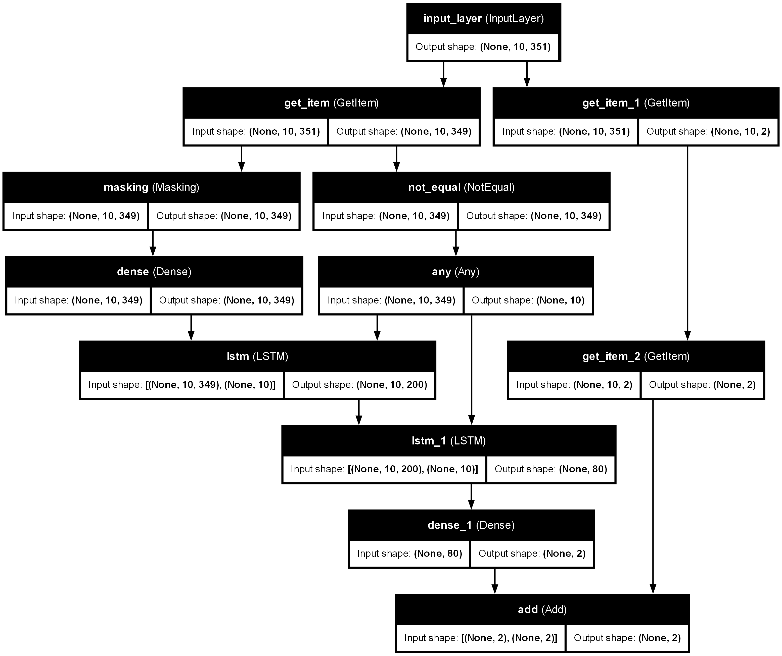
Model
Final attempt
→ Model effectively calculates the error of the WSL values
Notes:
Input split up -> Pre-calculated WSL values bypass the model
Masking
(Preprocessing dense layers)
LSTM layers
Final Dense layer with linear activation

Slide 10
Results
First optuna study
One dense layer
Variable LSTM layers
One dense layer

Slide 11
Results
Second optuna study
Varaibale dense layers
Varaible LSTM layers
One dense layer

Slide 12
Problems
Data loading and batching takes up too much RAM (solved)
Normalization not working (solved)
Data getting corrupted by type conversions and calculations (solved)
Model could not train for value range required (solved)
Computational resources and time

